Slide 1
Insight Action Results Performance Measurement Reporting System (PMRS)
Board of Higher Education Meeting – May 7, 2019

Slide 2
Introduction
Insight, Action, Results: Performance Measurement Reporting System

Slide 3
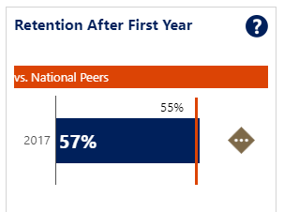
Suite of Analytic Resources
Insight, Action, Results: Performance Measurement Reporting System
Advancing Data-Driven Decision Making
Performance
Measurement Reporting System (Public)
Spotlight Reports (Public)
Shared Data Analytics Platform
(DHE/BHE & Campuses)
Systemwide Community of Practice for Data Analytics
Insight Action Results

Slide 4
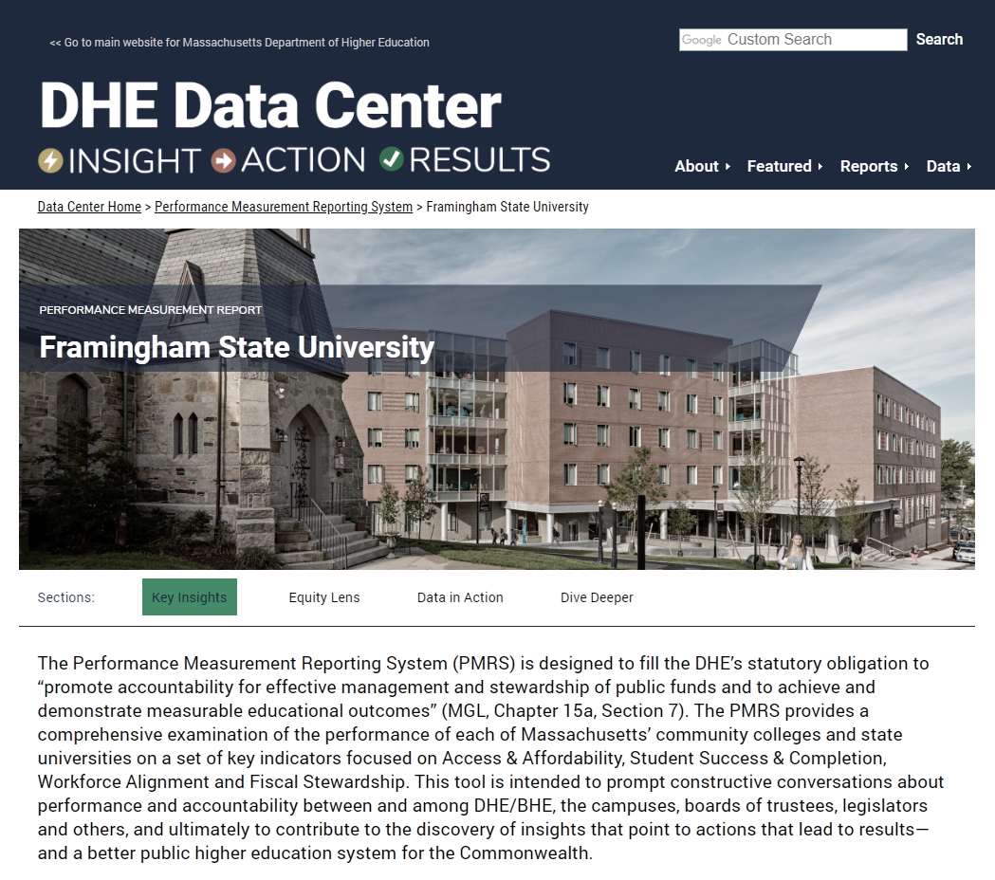
Public PMRS Reports
Insight, Action, Results: Performance Measurement Reporting System
www.mass.edu/datacenter

Slide 5
Student Success & Completion
PMRS Spotlight

Slide 6
RESULTS
Community Colleges

Slide 7
Insight: Importance of First-Year Progress
PMRS Spotlight: Student Success & Completion
“The research … suggests that increases in these near-term momentum rates should lead us to expect improved completion rates over a longer term.”

Slide 8
Action: Policy Implementations
PMRS Spotlight: Student Success & Completion
Individual campuses and the system have been implementing evidence-based practices associated with early momentum for the past decade:
Access
Aligning P-16 expectations (MassCore)
Offering dual enrollment, early college
Launching STEM Starter Academies, summer bridge programs
Remediation
Reforming placement standards
Implementing co-requisite at scale
Designing multiple math pathways
Note: Many of these innovations have been supported by DHE’s Performance Incentive Fund (PIF)
Success
Providing guided pathways (e.g., MassTransfer A2B Maps, GPSTEM)
Developing block schedules
Implementing early alert systems
Removing affordability barriers (e.g., Open Educational Resources, MASSGrant Plus)
Improving teaching through learning outcomes assessment

Slide 9
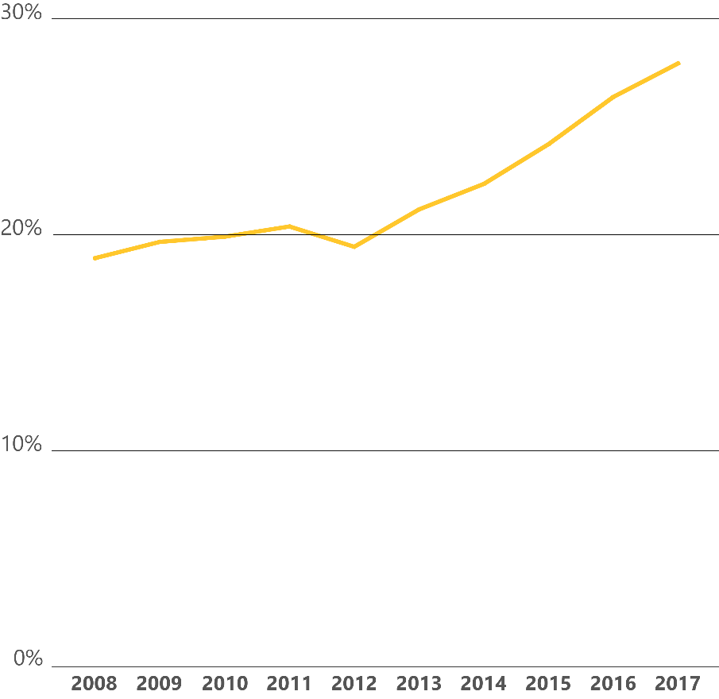
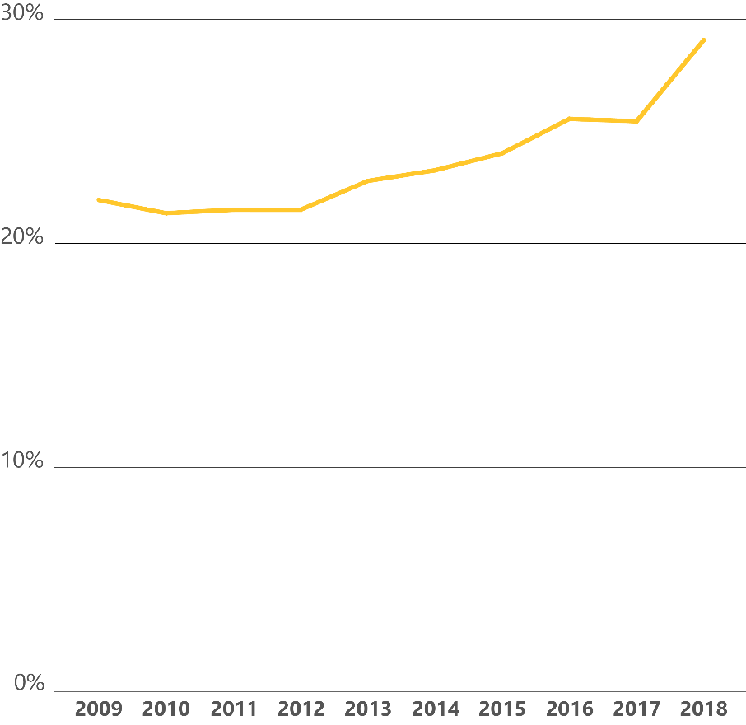
Results: Increases in First-Year Progress Rates
PMRS Spotlight: Student Success & Completion
Timely Completion of Gateway Courses*
Average Rate among Community Colleges
On-Time Credit Accumulation
Average Rate among Community Colleges
+7% points
+9% points
* Actual rates may be higher, so emphasis should be placed on change in rate, more than rate itself, at this time

Slide 10
Watching for: Increases in Success Rates
PMRS Spotlight: Student Success & Completion
Six-Year Comprehensive Student Success (VFA Model) Average Rate among Community Colleges
If the research holds true, success rates should start to increase in 2019, continuing through 2023

Slide 11
RESULTS
State Universities

Slide 12
Results: Overall Increases in Grad Rates
PMRS Spotlight: Student Success & Completion
Six-Year First-Time Student Graduation Rate Average Rate among State Universities
+7% points

Slide 13
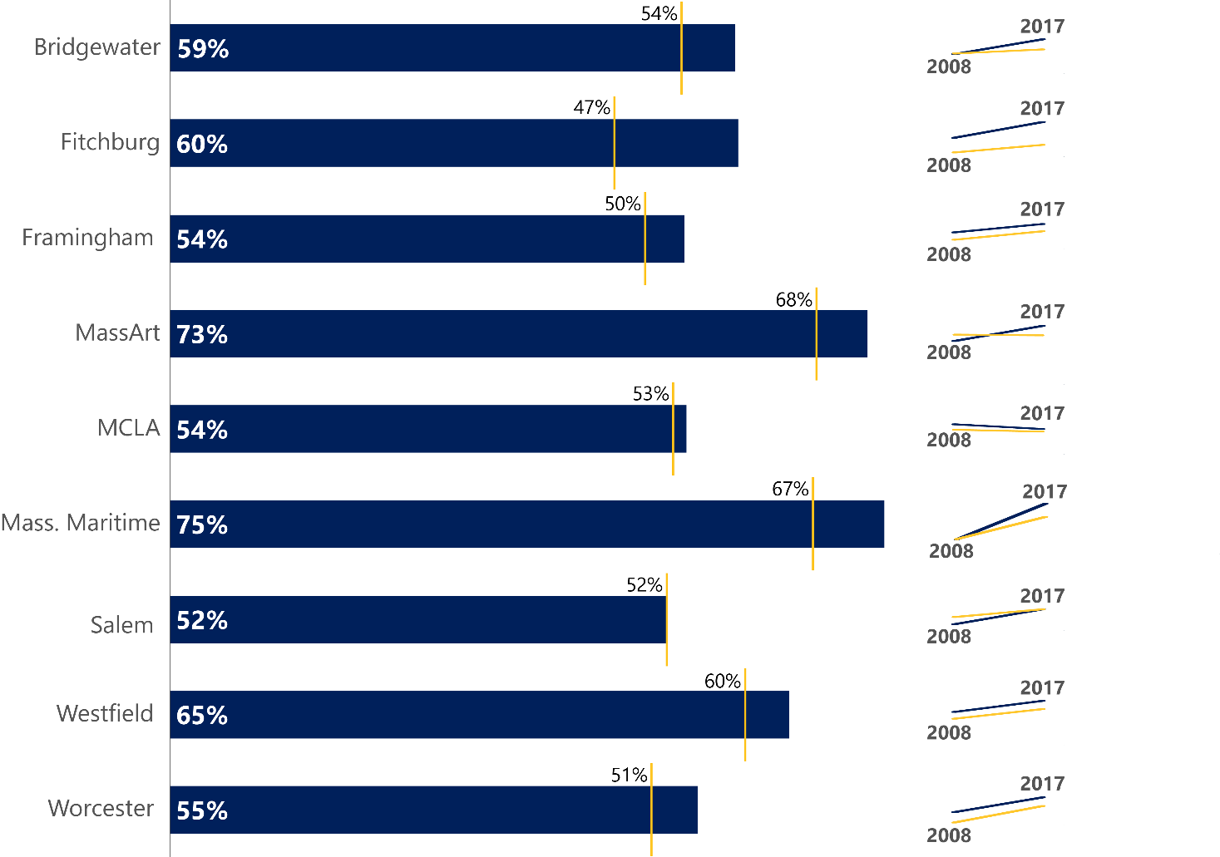
Results: Leaders Among National Peers
PMRS Spotlight: Student Success & Completion
Six-Year First-Time Student Graduation Rate State Universities Compared to Respective National Peer Groups (2017 and 10-year trend)

Slide 14
AREA FOR ACTION
State Universities
AREA FOR ACTION
Equity Gaps

Slide 15
Mixed Performance by Subgroup, and Gaps Remain
PMRS Spotlight: Student Success & Completion
Gaps by Race/Ethnicity Community College Student Success Metrics
Timely Completion of Gateway Courses
On-Time Credit Accumulation
First-Year Retention
Six-Year Student Success (VFA Model)

Slide 16
Mixed Performance by Subgroup, and Gaps Remain
PMRS Spotlight: Student Success & Completion
Gaps by Race/Ethnicity State University Student Success Metrics
Timely Completion of Gateway Courses
On-Time Credit Accumulation
First-Year Retention
First-Time Student Graduation

Slide 17
Next Steps: Continuous Improvement
PMRS Spotlight: Student Success & Completion
Data collection realignment
Benchmarking and goal-setting
Refinement of peer groups
Engaging stakeholders, seeking feedback

Slide 18
Discussion
Insight, Action, Results: Performance Measurement Reporting System

